Slide 1
Building Microsoft Graph Applications
Build a .NET console application using Microsoft Graph

Slide 2
Build a .NET console application using Microsoft Graph
Application registration
NuGet Packages
Application experience
Overview of the sample

Slide 3
Build a .NET console application using Microsoft Graph

Slide 4
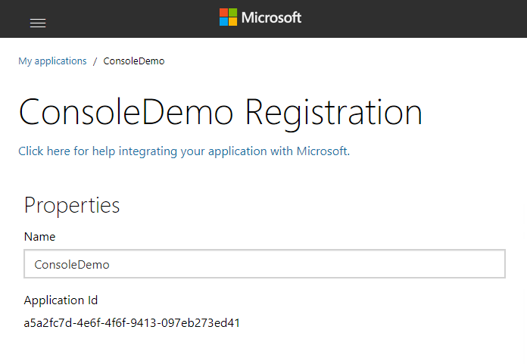
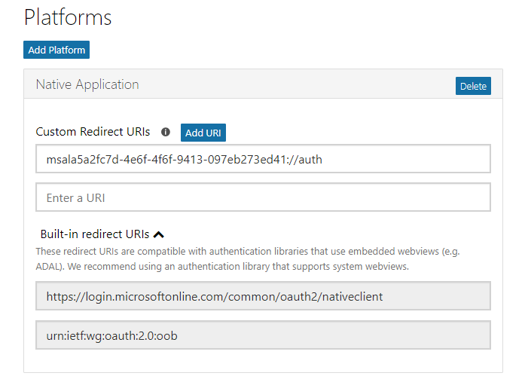
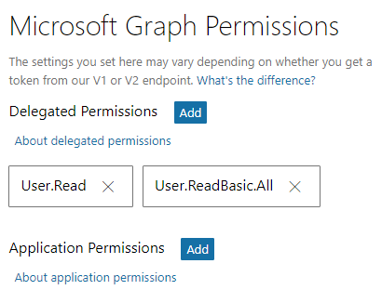
Application registration
Create a new application
Create a new application in the Application Registration Portal. A unique identifier is created for your app.
Add a Native Application platform
Add a Native Application platform to your application registration.
Add permissions
Add permissions that your application will need.

Slide 5
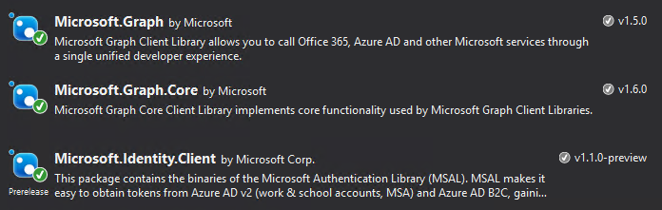
NuGet Packages
Notes:
Install-Package “Microsoft.Graph”
Install-Package “Microsoft.Identity.Client” -pre
The Microsoft.Graph.Core package will be installed with Microsoft.Graph as a dependency, as will Newtonsoft.Json.
The Microsoft.Identity.Client package is pre-release, make sure to include pre-release packages either using the checkbox in the GUI or including the –pre switch on the command line.

Slide 6
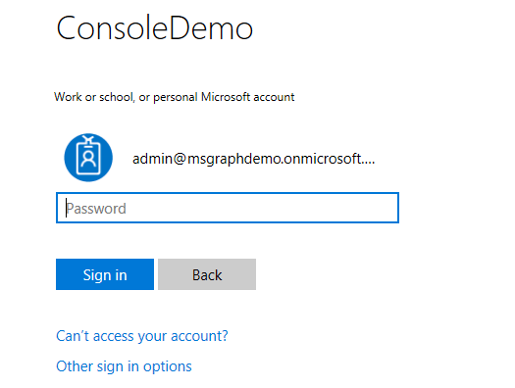
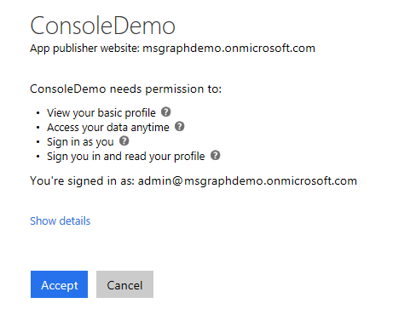
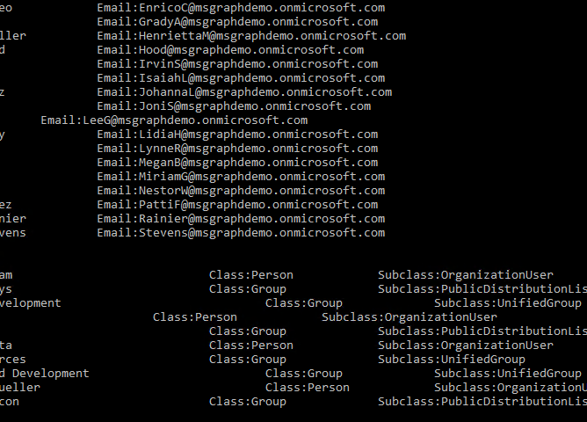
Application experience
User prompted to sign in
The user is prompted to sign in.
Prompt for consent
The user is prompted to grant consent to the application.
Data is securely returned
The Microsoft Graph API is queried and data is securely returned to the client.

Slide 7

Overview of the sample
Sign in, get token
Access token
Groups
Tasks
Teams
Calendar
Files
Get my profile
Chats
My profile
Microsoft Graph
Insights
Messages
Get basic information about all users
Coworkers
User
All users’ basic profile
Meetings
Devices
People

Slide 8
Authorization code grant and v2 endpoint
https://login.microsoftonline.com/common
Application
/common/OAuth/v2.0/authorize
/common/OAuth/v2.0/token
https://graph.microsoft.com
?scope=offline_access+openid+profile+User.Read+User.ReadBasic.All&response_type=code&client_id=…
Sign in, consent
authorization code
?scope=offline_access+openid+profile+User.Read+User.ReadBasic.All&grant_type=authorization_code&code=…
access_token, refresh_token, id_token
/v1.0/me (access token)
Current user’s profile
Token expires
?grant_type=refresh_token&refresh_token=…
access_token, refresh_token, id_token
/v1.0/me (access token)
Current user’s profile
Notes:
The call to /common/OAuth/v2.0/authorize will pop up a login screen and request permissions consent.
It is important to cache the refresh token to request a new access token.

Slide 9
Demo

Slide 10
Scenarios where this is useful
Enable a user to review and update their profile.
Review all user profiles and verify profile completeness. Send email to users reminding them to update their profile.
Enable a user to view people closely related to them and see what they are working on.

